Slide 1

Course Project 4: Self Attention
Hands on Artificial Intelligence and Robotics
Lingxiao Wang, Ph.D.
Assistant Professor of Electrical Engineering
Louisiana Tech University

Slide 2
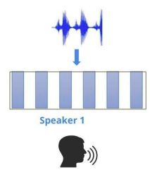
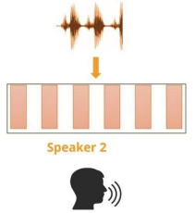
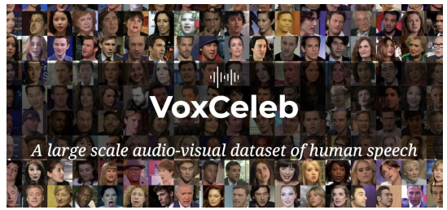
Task Introduction – Speaker Identification
Objective:
Predict the speaker identification from given speech.
Dataset:
VoxCeleb2
Sound record of 600 different speakers

Slide 3
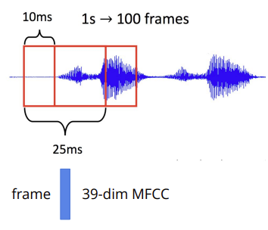
Audio Signal Pre-processing
We will divide a sound signal into multiple frames and design a neural network to classify phoneme.
One frame is 25 ms:
1 second sound signal contains 100 frames (overlapping in frames)
The distance between two consecutive frames is 10 ms.

Slide 4
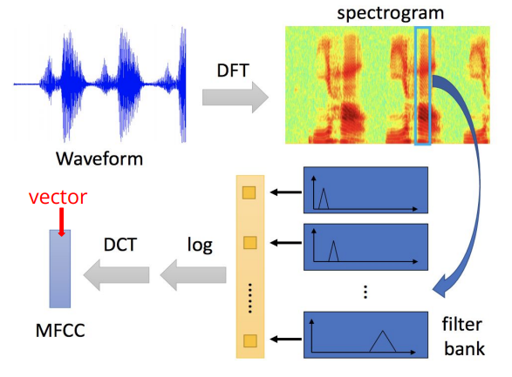
Audio Signal Pre-processing
MFCC (Mel Frequency Cepstral Coefficients) – Acoustic Features.
Convert a frame of sound signals into a vector.

Slide 5
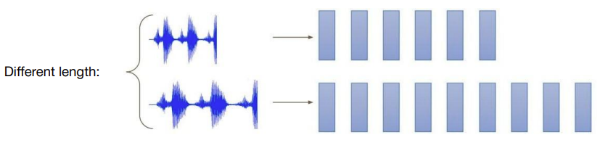
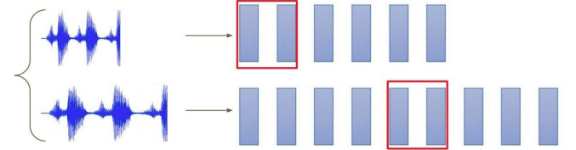
Data Segmentation During Training
Different audio signals will produce sequences with varying length.
During the training, we won’t use the whole vectors, but pick a fixed length of vectors.
Segment = 128

Slide 6
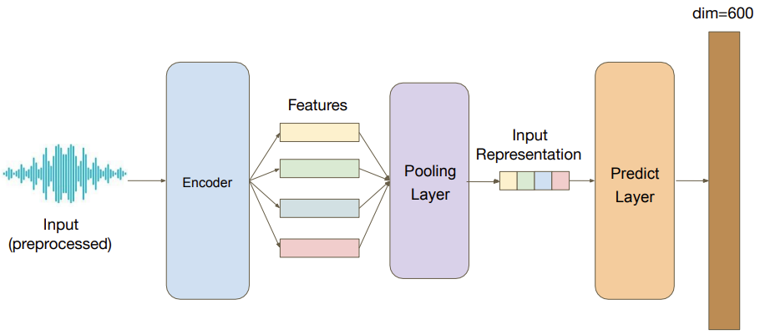
Model Architecture

Slide 7
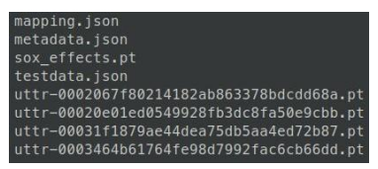
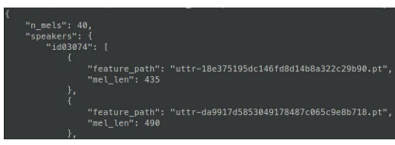
Data Format
Data Directory:
Metadata.json
The source of all audio signals and speaker information
Testdata.json
The testing data
Mapping.json
Speaker name -> speaker_id
Uttr-{audioID}.pt
Processed Audio signal.
The information in metadata
N_mels: the number of features
Speakers: A dictionary:
Key – speaker_id;
Value – feature_path & mel_len (length of a feature)
Metadata

Slide 8
Grading Policy
 | Test Accuracy | Hint | Grade
Simple Baseline | >0.5 | Run the sample code | 80
Medium Baseline | >0.6 | Change the encoder parameters (reference [1]) | 90
Strong Baseline | >0.7 | Use Conformer, a variety of Transformer | 95
Boss Baseline | >0.8 | Implement Self-attention pooling | 100
[1] Attention is all you need. https://arxiv.org/pdf/1706.03762.pdf

Slide 9
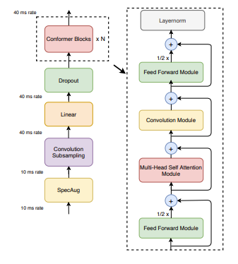
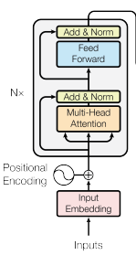
Conformer
https://arxiv.org/pdf/2005.08100.pdf
Conformer is a variant in Transformer, which includes a convolution model between the self attention and fully connected layers.
Conformer in Pytorch: https://pytorch.org/audio/main/generated/torchaudio.models.Conformer.html
Conformer Architecture
Transformer Encoder Architecture

Slide 10
Conformer
Solution for no Audio Backbone:
https://stackoverflow.com/questions/62543843/cannot-import-torch-audio-no-audio-backend-is-available
Other Conformer Implementation:
https://github.com/lucidrains/conformer

Slide 11
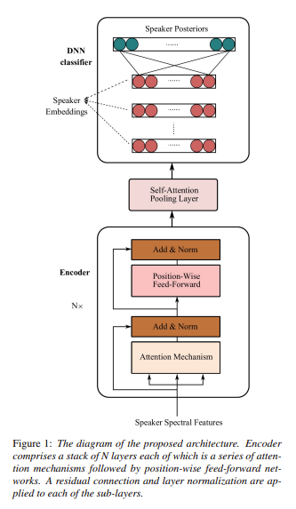

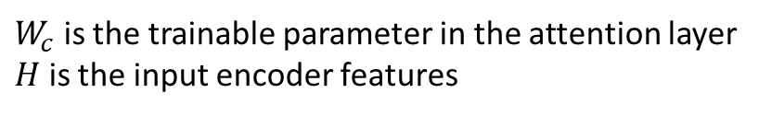
Self-attention pooling
https://arxiv.org/pdf/2008.01077v1.pdf
$W_{c}$ is the trainable parameter in the attention layer
$H$ is the input encoder features

Slide 12
Sample Code
https://colab.research.google.com/drive/1pVbwIkiMcqCpBxb90BN7Wfm2fW-eFRFk?usp=sharing

